Slide 1
NOVAMED SOLUTIONS
Sales Performance Analysis and Reporting
Presented by: Opeyemi Olaniran
Company: 10nalytics
Date: May 17,2025

Slide 2
INTRODUCTION
NovaMed Solutions is a leading pharmaceutical distributor, serving a diverse healthcare sector, ensuring the availability of essential medications.
However, inefficiencies in demand forecasting, stock management, and customer engagement strategies have impacted operational effectiveness.
Over the past year, NovaMed Solutions has collected comprehensive sales data, including revenue, profit margins, drug performance, and customer demographics. This dataset provides a valuable opportunity for in depth analysis, trend identification, and data driven decision making to enhance business strategies and streamline operations.

Slide 3

KEY MARKET TRENDS
NovaMed Solutions has made remarkable growth over the last 5 years across six countries and three continents including Canada, USA, Australia, France, UK and Germany.
Total Revenue generated was $71.31M – with a 4.22% YoY increase and $68.42M from the previous year. However, the highest monthly revenue generated was in July 2023- $5.80M.
Total quantity sold was 260,472- with a 4.20% YoY increase and 258,616 from previous year.
Total Profit made was $58.45M- with a 4.28% YoY increase and a profit margin of 81.97%.
Total Expenses was $12.85M - with a 3.91% YoY increase and a previous expenses of $12.37M.

Slide 4
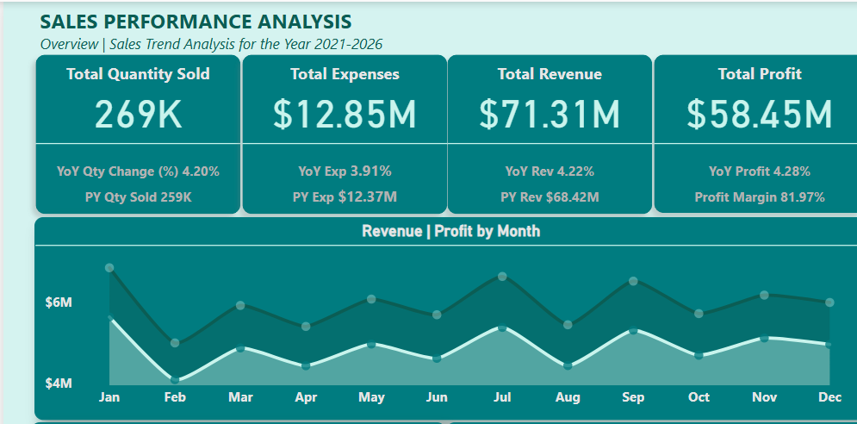
KEY MARKET TRENDS

Slide 5
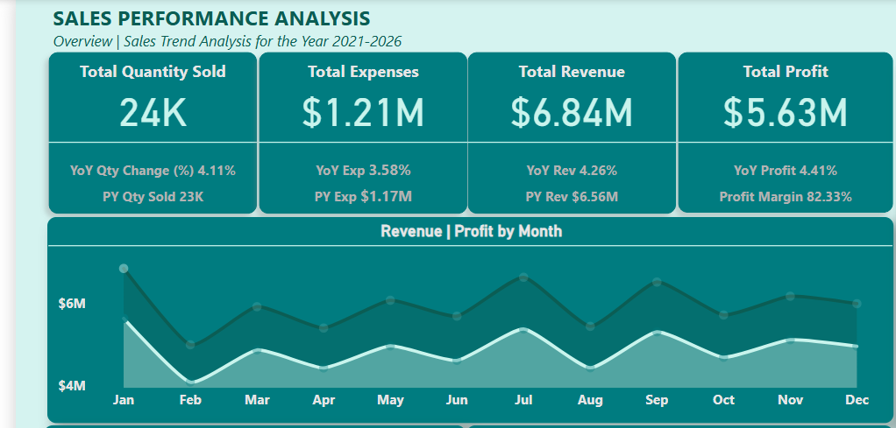
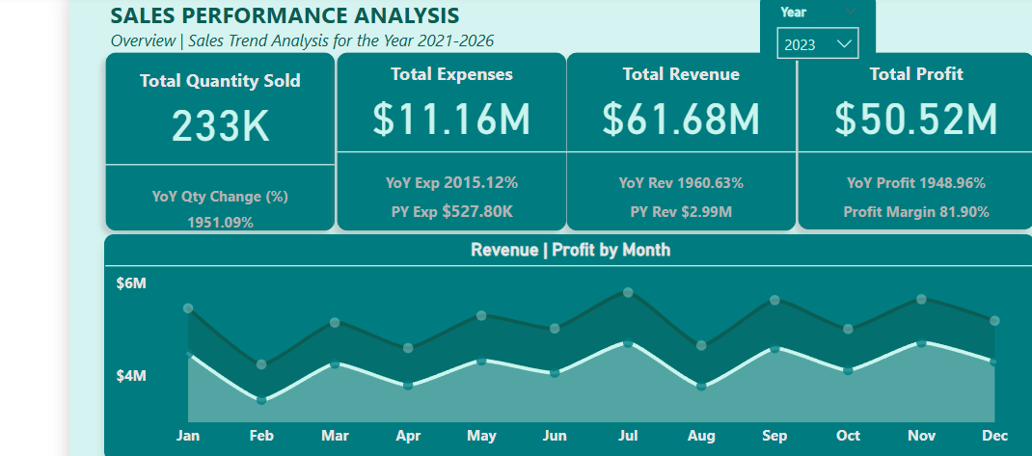
SALES TREND ANALYSIS
Overall, the highest profit and revenue generated was in the month of January with the total quantity sold of about 24,000. This yielded a total revenue of $6.84M and a profit of $5.63M.
The highest sales was in the year 2023, yielding a total revenue of $61.68M with a 1960.63% YoY increase and a total profit of $50.52M with a 1948.96% YoY increase. However, the total expenses was $11.16M compared to that of the previous year-$527, 800

Slide 6
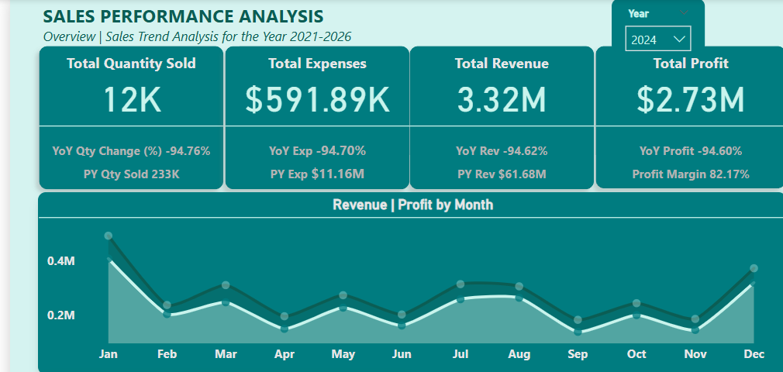
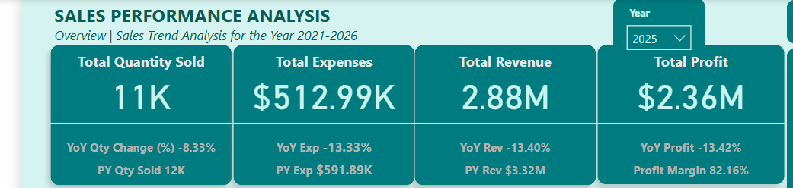
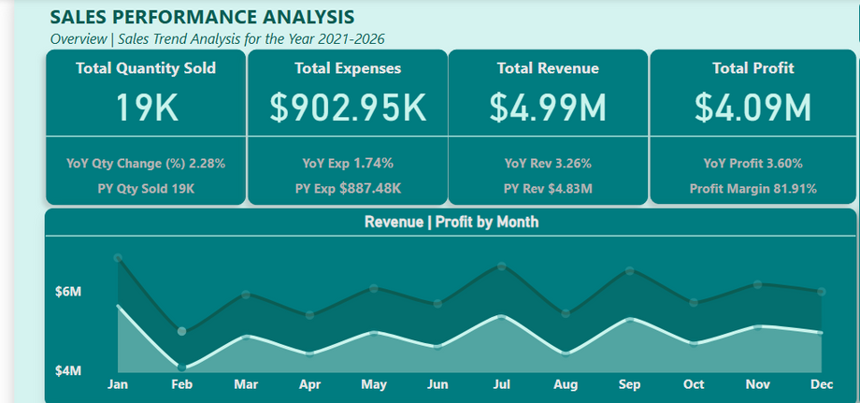
SALES TREND ANALYSIS
In the year 2024, there was a significant decline in the total revenue of $3.32M with a 94.62% YoY decrease and a total profit of $2.73M with a 94.60% YoY decrease.
In 2025, the company also experienced a decline in the revenue and profit, with a 13.40% YoY decrease and a 13.42% YoY decrease respectively. This could be due to reduction in demand and supply of products.
There was limited data availability for the year 2026, therefore analysis compared to the previous is limited.
Overall, the lowest profit and revenue generated was in the month of February with the total quantity sold of about 19,000. This yielded a total revenue of $4.99M and a profit of $4.09M.

Slide 7

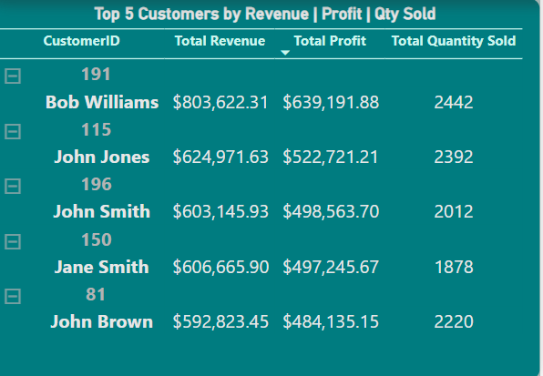
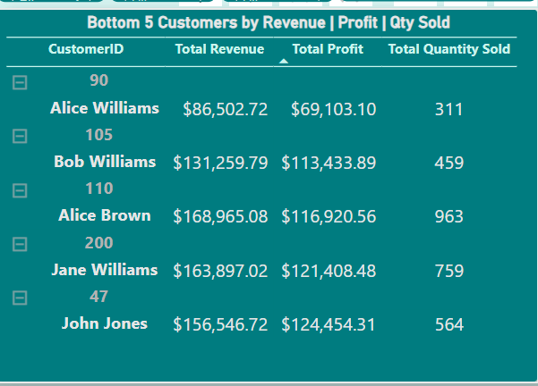
Top | Bottom 5 Customers by Revenue, Profit and quantity sold
Bob Williams with the Customer ID 191 is the top performing customer. In five years, he sold a total of 2,442 products which generated a total revenue of $803,622 and a total profit of $639,191.
Alice Williams with the Customer ID 90 is the lowest performing customer. She sold a total of 311 products, generating a total revenue of $86,502 and a total profit of $69,103 over 5 years.

Slide 8
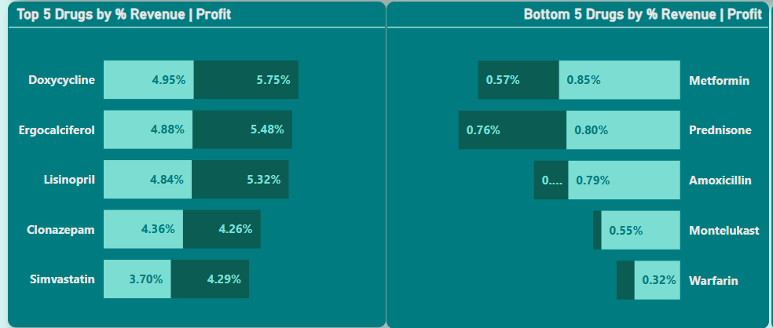
Top | Bottom 5 Drugs by Revenue and Profit
Doxycycline is the topmost performing drug generating a total revenue of $3.53M (4.95%) and a total profit of $3.36M (5.75%) with a low cost of production of about $173,000. However, Lisinopril is the best selling drug with about 11,000 quantity sold over five years
Montelukast is the least performing drug in total profit- $32,900(0.06%) with a high cost of production- $362,110 compared to the revenue generated-$395,080(0.55%)
Although, Warfarin ranks the lowest in total revenue of $229,249 (0.32%)

Slide 9
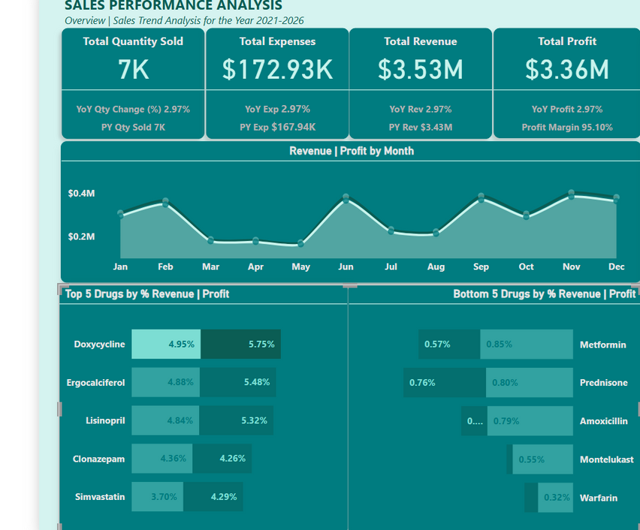
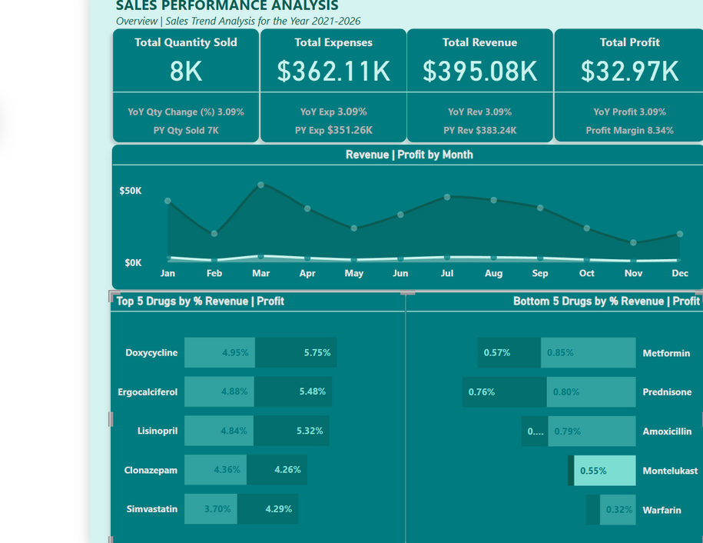
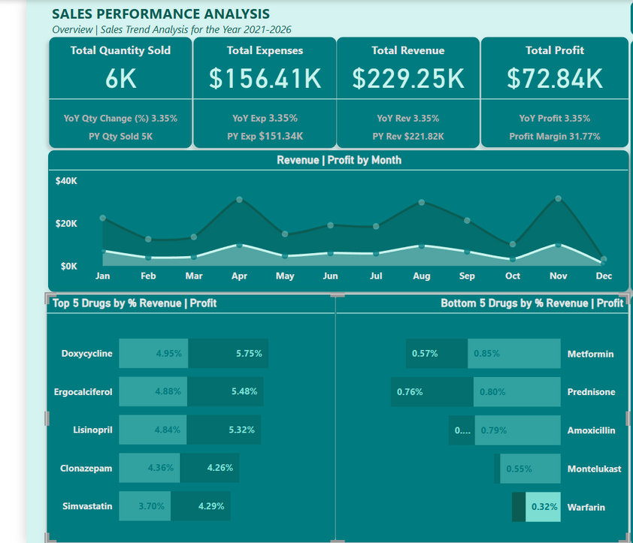
Revenue Streams from Doxycycline
Revenue Streams from Montelukast
Revenue Streams from Warfarin

Slide 10

RECOMMENDATIONS
1. Take advantage of Peak Sales Periods-Identify months with consistently high sales and align marketing campaigns to coincide with those periods.
2. Investigate the decline in sales-Analyze periods of declining sales to determine root causes (e.g., seasonality, inventory issues, pricing changes) and develop mitigation plans or replicate strategies from high-performing months.
3. Focus on Top performing drugs - invest more on top performing drugs like Doxycycline and Lisinopril to maximize profit in top performing locations.
4. Strengthen underperforming drugs- consider promotions and discounts for drugs like Warfarin and Montelukast
5. Customer Leverage- Strengthen partnerships with high-performing customer and offer incentives to encourage the low-tier ones.
6. Inventory management- ensure the inventory count aligns with the sales trend to prevent overstocking or understocking during peak sales periods.

Slide 11
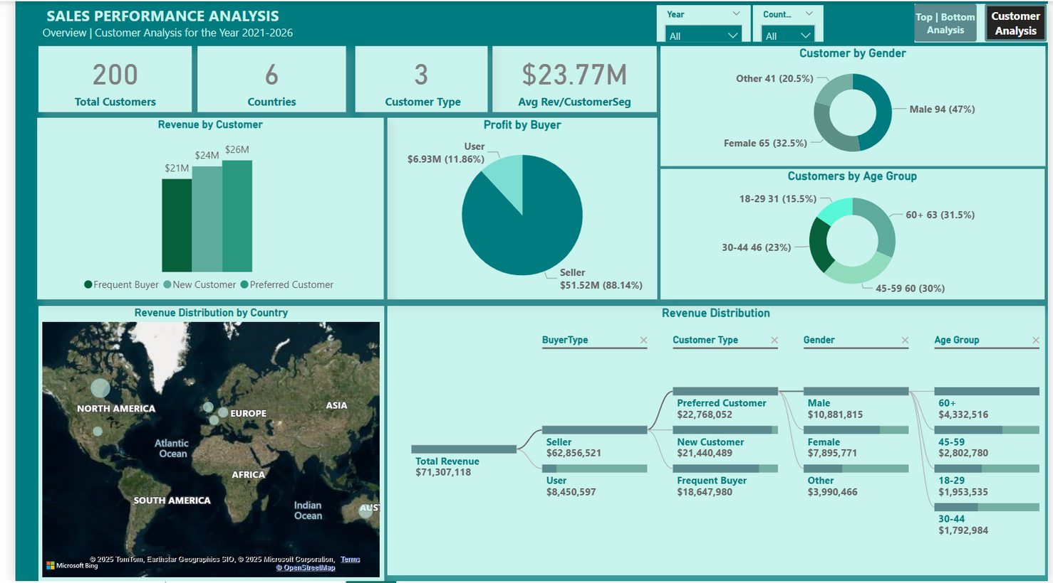
CUSTOMER ANALYSIS
NovaMed Solutions had 200 customers and three customer types- Frequent, Preferred and New customers, across six countries in five years.
66 of the total customers were frequent buyers, 67 are new customers and 67 are preferred customers.
Average revenue generated per customer type was $20.95M.

Slide 12
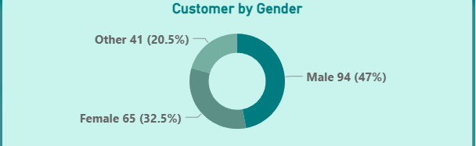
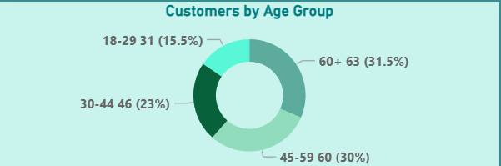
CUSTOMER BY GENDER | AGE GROUP
94 out of the 200 customers were Males accounting for 47% of the customer base, and 65 were Females (32.5%) and the rest were other gender identities(20.5%).
The customers were grouped into 4 age groups- Young adult (18-29), Adult (30-44), Middle aged (45-59) and the Elderly (60+).
The Elderly (60+) age group accounted for 31.5% (63 customers) of the total customers, of which 16% (32 customers) were male. The least number of customers were the Young adult- 31 customers(15.5%)

Slide 13
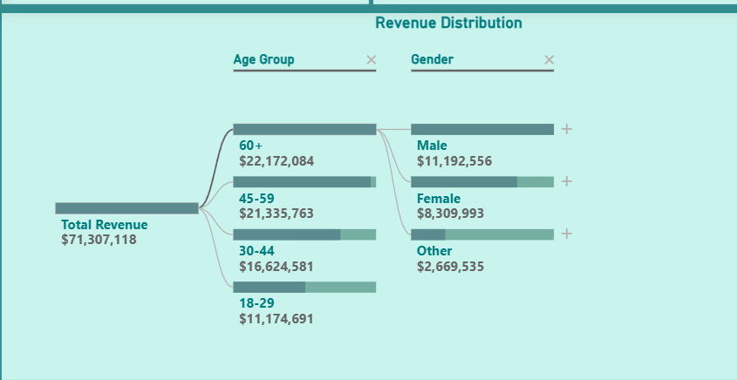
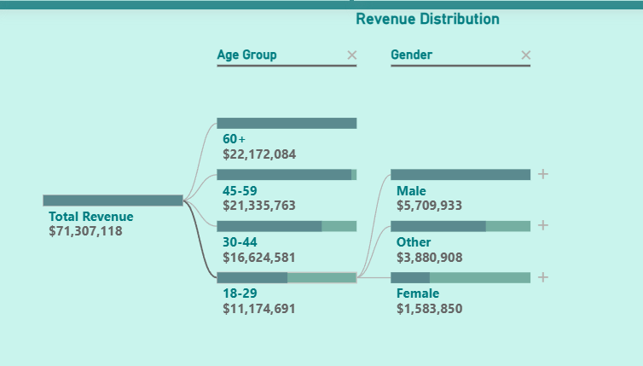
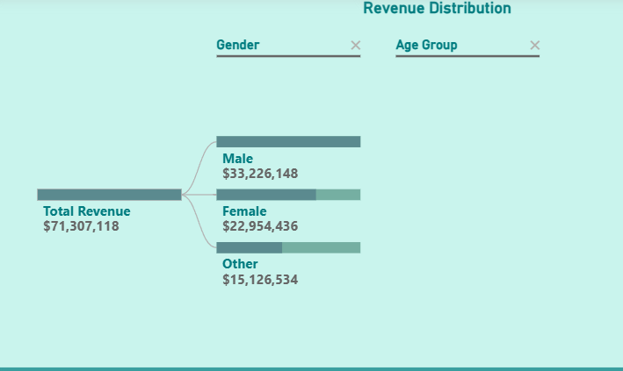
REVENUE BY GENDER | AGE
The least generated revenue was from the Young Adult, which was about $11.17M, with majority from the males, about $5.71M.
The most generated revenue was from the Elderly age group (60+), which was about $22.17M, with the males generating about $11.19M.
Overall, the male gender generated the most revenue of $33.23M while Others generated the least revenue of about $15.13M.

Slide 14
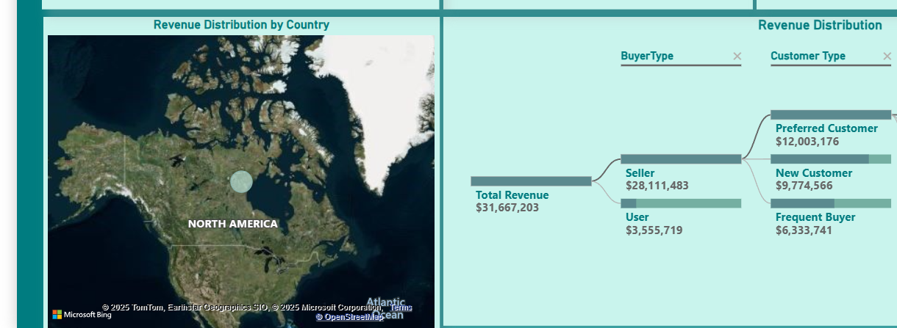
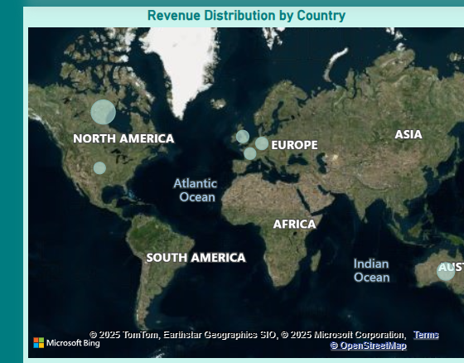
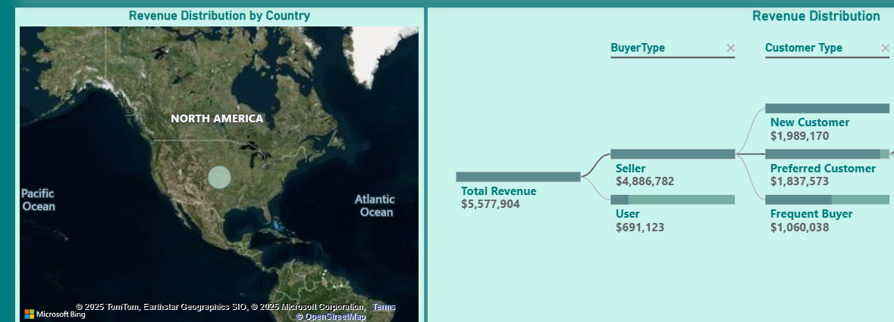
REVENUE DISTRIBUTION BY COUNTRY
Canada was the best performing location generating about $31.67M in total revenue and $25.91M in total profit.
The least performing location was the USA generating a total revenue of $5.577M and a total profit of $4.58M.

Slide 15
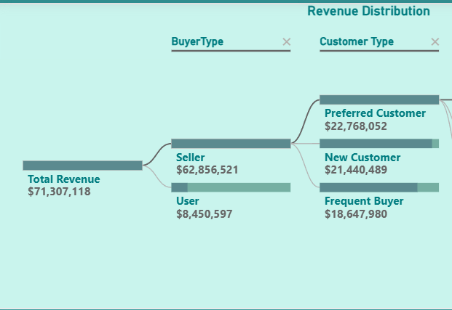
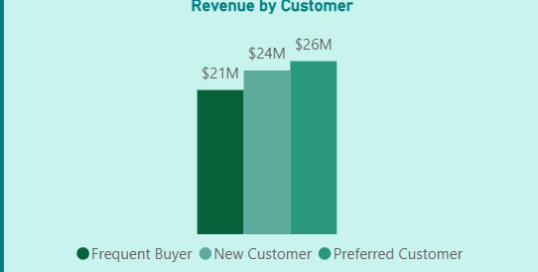
REVENUE DISTRIBUTION BY BUYER | CUSTOMER TYPE
In terms of buyer types, sellers generated more revenue of $62.86M and profit of $51.52M than users over a period of five years.
Preferred Customers yielded the highest revenue, about $25.65M while the frequent buyers generated the least revenue of $21.38M.

Slide 16
RECOMMENDATIONS
Target the High-value Customers- Prioritize marketing spend on the Preferred customers, the male gender and the Elderly age group (60+) who generate the most revenue.
Improve Customer engagement- launch loyalty or rewards programs, exclusive offers, or early access to drugs to the new customers and the Young adult age group (18-29) so as to reinforce loyalty.
Prioriotize High revenue regions- Prioritize marketing and sales efforts in countries like Canada and Australia, where high revenues are generated.
Invest in localized campaigns and promotions for top performing locations- Canada and Australia. This will improve sales of products in these locations.
Evaluate Low performing locations - Investigate underperforming countries- USA and France, to understand potential barriers (e.g., poor distribution, lack of awareness) and consider pricing adjustments and targeted awareness campaigns.
Monitor trends in sales in the six countries- Track revenue and sales performance by region over time and take action quickly to any emerging declines in the regions.

Slide 17
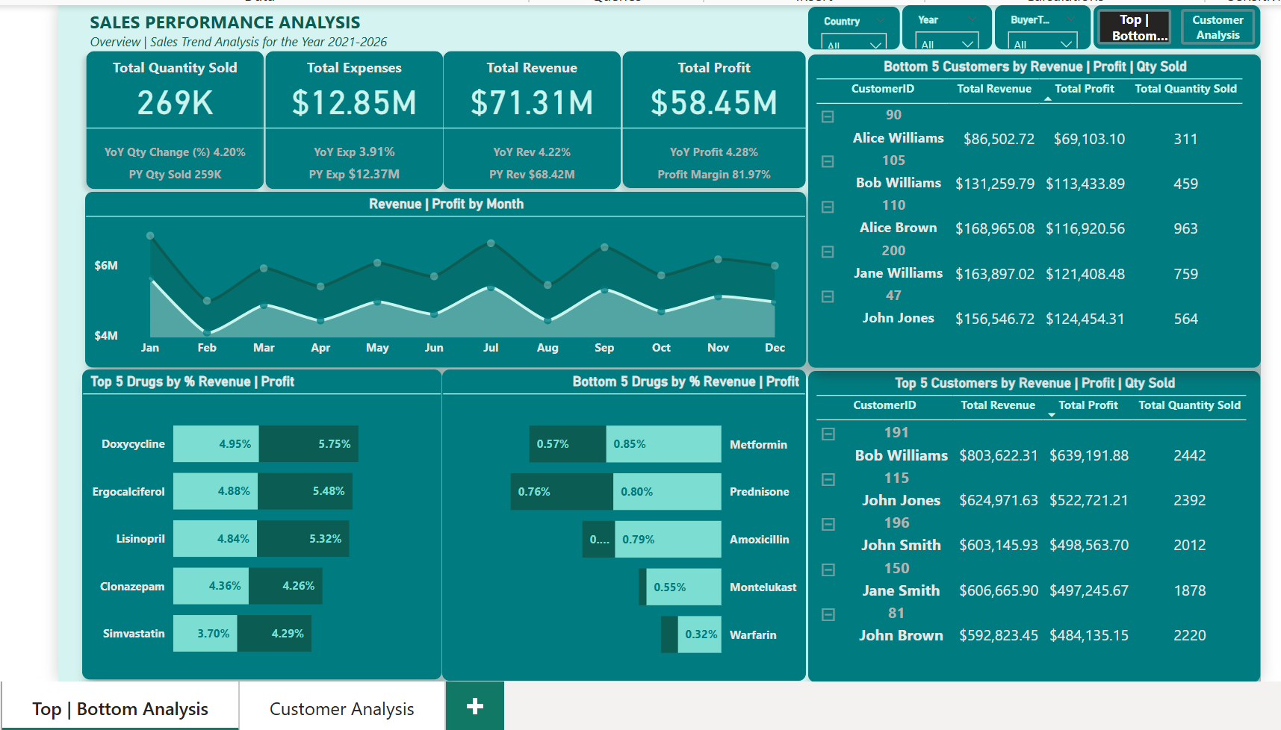
TOP | BOTTOM ANALYSIS DASHBOARD

Slide 18
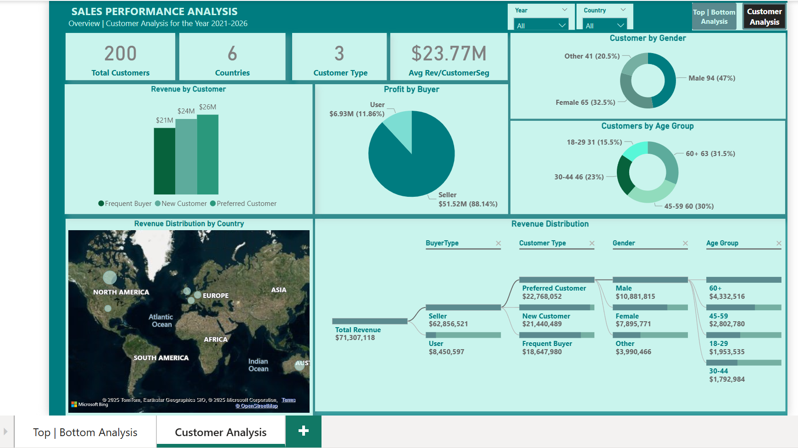
CUSTOMER ANALYSIS DASHBOARD

Slide 19
Thank You for your Attention

